Slide 1












Table Of Contents
Wireless Doorbell
Presented by : Grisma Poudel, Yoshin Shrestha, Aarushi Thapa, Prakriti Regmi, Trishna Thapa, Supriya Thapa, Uttrina Thapa
Organizers :
Helper :

Slide 2

Table Of Contents
Wireless Doorbell
Helper :
Organizers :
Presented by : Grisma Poudel, Yoshin Shrestha, Aarushi Thapa, Prakriti Regmi, Trishna Thapa, Supriya Thapa, Uttrina Thapa

Slide 3




Introduction
About The Project.

Slide 4
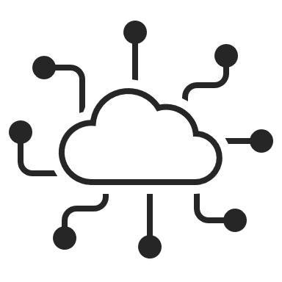




List Of Components
Components used to make the Wireless door sensor.

Slide 5



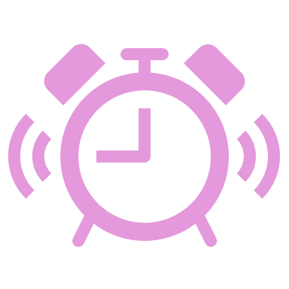
Working Mechanism
How the Components work.

Slide 6




Code and Its Working
The Code through which the Doorbell works.

Slide 7



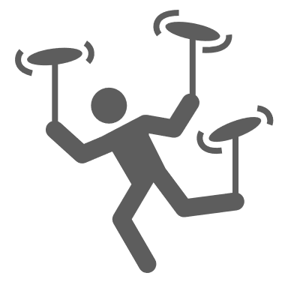
Application
The Sectors where we can apply this project.

Slide 8




INTRODUCTION
Possible Enhancements
What Changes we can do to make our project Better.
Introduction

Slide 9



Wireless Doorbell
INTRODUCTION
A wireless doorbell is a modern, convenient alternative to traditional wired doorbells, designed to alert homeowners to visitors without the need for complex electrical wiring. Introduced as a user-friendly solution, wireless doorbells gained popularity in the late 20th century with advancements in radio frequency (RF) technology, offering easy installation and flexibility for homes, apartments, and offices. Unlike wired systems, which require professional installation and permanent modifications, wireless doorbells are portable, affordable, and ideal for renters or those seeking simple setups. They consist of a push-button transmitter placed at the door and a receiver that chimes or flashes indoors, making them both practical and versatile.

Slide 10

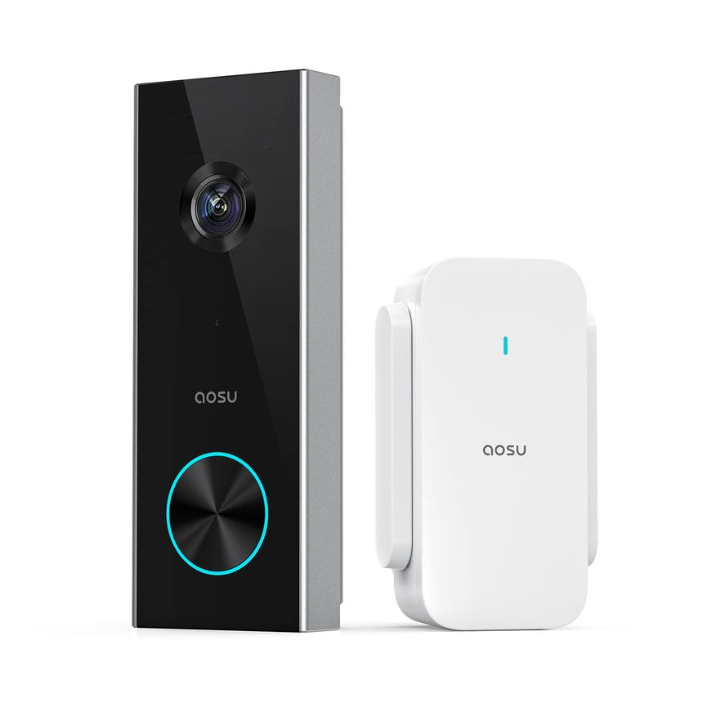


Why use Wireless Doorbell ?
Wireless Doorbell
A wireless doorbell is a modern, convenient alternative to traditional wired doorbells, designed to alert homeowners to visitors without the need for complex electrical wiring. Introduced as a user-friendly solution, wireless doorbells gained popularity in the late 20th century with advancements in radio frequency (RF) technology, offering easy installation and flexibility for homes, apartments, and offices. Unlike wired systems, which require professional installation and permanent modifications, wireless doorbells are portable, affordable, and ideal for renters or those seeking simple setups. They consist of a push-button transmitter placed at the door and a receiver that chimes or flashes indoors, making them both practical and versatile.
INTRODUCTION

Slide 11
A wireless doorbell is a modern, convenient alternative to traditional wired doorbells, designed to alert homeowners to visitors without the need for complex electrical wiring. Introduced as a user-friendly solution, wireless doorbells gained popularity in the late 20th century with advancements in radio frequency (RF) technology, offering easy installation and flexibility for homes, apartments, and offices. Unlike wired systems, which require professional installation and permanent modifications, wireless doorbells are portable, affordable, and ideal for renters or those seeking simple setups. They consist of a push-button transmitter placed at the door and a receiver that chimes or flashes indoors, making them both practical and versatile.
Why use Wireless Doorbell ?
Wireless Doorbell
3
List Of Components
Portable
4
2
INTRODUCTION
Durable
Low Maintenance
1
5
Customizable
Affordability

Slide 12
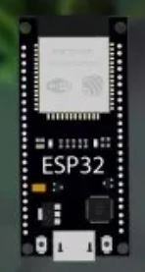
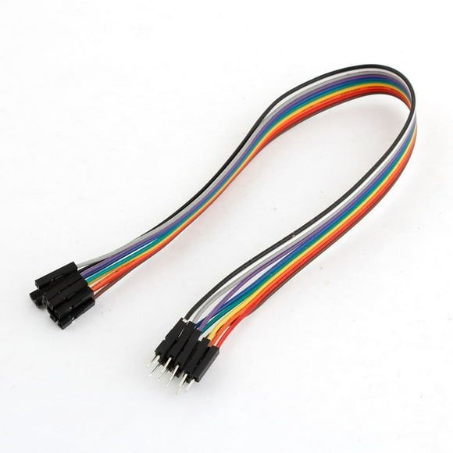
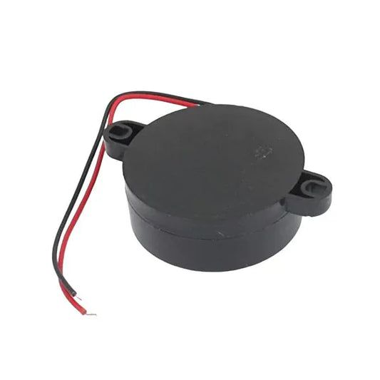
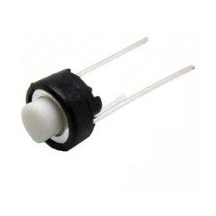
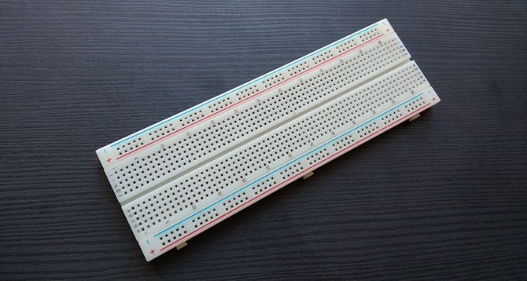
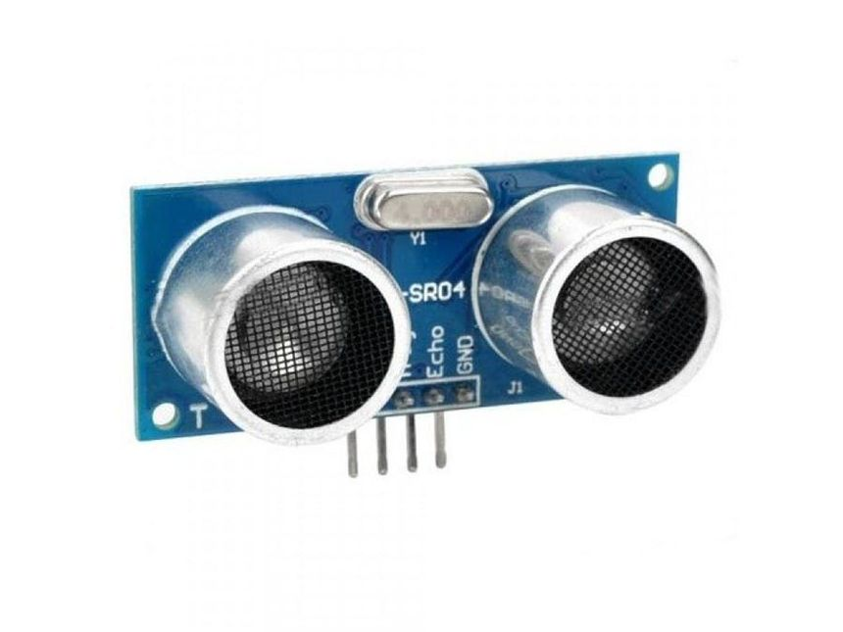
3
Portable
2
Durable
4
Why use Wireless Doorbell ?
Low Maintenance
Switch
Buzzer
Jumper Wire
ESP 32
Ultrasonic Sensor
Breadboard
Jumper Wires are short, insulated electrical wires used to connect components in electric circuit, typically on breadboards or prototyping boards.
Jumper wires connect all the components in the prototype board.
It has a length of 10 to 30 cm.
It can be used in breadboards,ESP32, ArduinoUNO, etc.
It is a manual control that completes or breaks a circuit, triggering the doorbell buzzer when pressed in the prototype.
It allows the user to physically press and toggle around the circuit
Used in any Circuits requiring Press function.
A buzzer is an electromechanical or piezoelectric device that produces sound from an electric signal.
Converts electrical signals into vibrations producing tones or beep.
Used in alarms, timer, notification, toys, electronic devices.
ESP 32 is a low cost, low power system on chip(SoC) with dual – core and single core Tensilica Xtensa LX6 microprocessor, develop by Espressif System.
It uses dual core processor with 520 KB SRAM and up to 4 MB flash memory.
It consists of 36 GPIO pins.
Principle: This sensor transmits an Ultrasonic ray through which it determines how far the object is.
Range: The sensor can detect object from a few centimeters away depending on how it is coded.
Components: It consists of a Transmitter(T) and receiver(R).
Application: It is used in object measurement,detection, robotics, parking sensors.
A Breadboard is a construction base used to build semi permanent prototype of Electric Circuit.
Used for learning electronics and circuit design.
Works with jumper wires, IC’s, resistors, capacitors, ESP32, etc.
Affordable ranging from $2 to $10.
List Of Components
1
5
Affordability
Customizable

Slide 13



Ultrasonic Sensor
Breadboard
Jumper Wire
ESP 32
Buzzer
Switch
Principle: This sensor transmits an Ultrasonic ray through which it determines how far the object is.
Range: The sensor can detect object from a few centimeters away depending on how it is coded.
Components: It consists of a Transmitter(T) and receiver(R).
Application: It is used in object measurement,detection, robotics, parking sensors.
Jumper Wires are short, insulated electrical wires used to connect components in electric circuit, typically on breadboards or prototyping boards.
Jumper wires connect all the components in the prototype board.
It has a length of 10 to 30 cm.
It can be used in breadboards,ESP32, ArduinoUNO, etc.
ESP 32 is a low cost, low power system on chip(SoC) with dual – core and single core Tensilica Xtensa LX6 microprocessor, develop by Espressif System.
It uses dual core processor with 520 KB SRAM and up to 4 MB flash memory.
It consists of 36 GPIO pins.
A buzzer is an electromechanical or piezoelectric device that produces sound from an electric signal.
Converts electrical signals into vibrations producing tones or beep.
Used in alarms, timer, notification, toys, electronic devices.
It is a manual control that completes or breaks a circuit, triggering the doorbell buzzer when pressed in the prototype.
It allows the user to physically press and toggle around the circuit
Used in any Circuits requiring Press function.
A Breadboard is a construction base used to build semi permanent prototype of Electric Circuit.
Used for learning electronics and circuit design.
Works with jumper wires, IC’s, resistors, capacitors, ESP32, etc.
Affordable ranging from $2 to $10.
Working Of
Components
List Of Components

Slide 14


Ultrasonic Sensor
Working Of
Components
Switch
Buzzer
Jumper Wire
ESP 32
Ultrasonic Sensor
Breadboard
Jumper Wires are short, insulated electrical wires used to connect components in electric circuit, typically on breadboards or prototyping boards.
Jumper wires connect all the components in the prototype board.
It has a length of 10 to 30 cm.
It can be used in breadboards,ESP32, ArduinoUNO, etc.
It is a manual control that completes or breaks a circuit, triggering the doorbell buzzer when pressed in the prototype.
It allows the user to physically press and toggle around the circuit
Used in any Circuits requiring Press function.
A buzzer is an electromechanical or piezoelectric device that produces sound from an electric signal.
Converts electrical signals into vibrations producing tones or beep.
Used in alarms, timer, notification, toys, electronic devices.
ESP 32 is a low cost, low power system on chip(SoC) with dual – core and single core Tensilica Xtensa LX6 microprocessor, develop by Espressif System.
It uses dual core processor with 520 KB SRAM and up to 4 MB flash memory.
It consists of 36 GPIO pins.
Principle: This sensor transmits an Ultrasonic ray through which it determines how far the object is.
Range: The sensor can detect object from a few centimeters away depending on how it is coded.
Components: It consists of a Transmitter(T) and receiver(R).
Application: It is used in object measurement,detection, robotics, parking sensors.
A Breadboard is a construction base used to build semi permanent prototype of Electric Circuit.
Used for learning electronics and circuit design.
Works with jumper wires, IC’s, resistors, capacitors, ESP32, etc.
Affordable ranging from $2 to $10.
The HC-SR04 ultrasonic sensor detects a visitor’s presence by emitting 40 kHz ultrasonic waves and measuring the time for the echo to return after hitting an object, calculating distances from 2 cm to 4 meters. Mounted near the door, it sends a short pulse via its TRIG pin to initiate wave emission, with the ECHO pin outputting a pulse duration proportional to the distance, which the ESP32 processes to trigger the doorbell when an object (e.g., a person) is within a set range (<50 cm). Connected via jumper wires on the breadboard, it provides reliable, non-contact distance data for the system.

Slide 15
Breadboard
Ultrasonic Sensor
Working Of
Components
The HC-SR04 ultrasonic sensor detects a visitor’s presence by emitting 40 kHz ultrasonic waves and measuring the time for the echo to return after hitting an object, calculating distances from 2 cm to 4 meters. Mounted near the door, it sends a short pulse via its TRIG pin to initiate wave emission, with the ECHO pin outputting a pulse duration proportional to the distance, which the ESP32 processes to trigger the doorbell when an object (e.g., a person) is within a set range (<50 cm). Connected via jumper wires on the breadboard, it provides reliable, non-contact distance data for the system.
The breadboard acts as a solderless, reusable platform for assembling the wireless doorbell circuit, hosting all components and enabling easy connections without permanent soldering. Its terminal strips (interconnected rows for components) and power rails (for VCC and GND distribution) organize the setup, supporting the ultrasonic sensor, ESP32, Arduino UNO, and buzzer via jumper wires. This modular structure allows for rapid prototyping, troubleshooting, and circuit adjustments, making it ideal for testing the doorbell system.

Slide 16
Jumper Wire
Ultrasonic Sensor
Breadboard
The HC-SR04 ultrasonic sensor detects a visitor’s presence by emitting 40 kHz ultrasonic waves and measuring the time for the echo to return after hitting an object, calculating distances from 2 cm to 4 meters. Mounted near the door, it sends a short pulse via its TRIG pin to initiate wave emission, with the ECHO pin outputting a pulse duration proportional to the distance, which the ESP32 processes to trigger the doorbell when an object (e.g., a person) is within a set range (<50 cm). Connected via jumper wires on the breadboard, it provides reliable, non-contact distance data for the system.
The breadboard acts as a solderless, reusable platform for assembling the wireless doorbell circuit, hosting all components and enabling easy connections without permanent soldering. Its terminal strips (interconnected rows for components) and power rails (for VCC and GND distribution) organize the setup, supporting the ultrasonic sensor, ESP32, Arduino UNO, and buzzer via jumper wires. This modular structure allows for rapid prototyping, troubleshooting, and circuit adjustments, making it ideal for testing the doorbell system.
Jumper wires serve as flexible electrical conduits, connecting components on the breadboard to establish power, ground, and signal pathways. Available in male-to-male, male-to-female, and female-to-female configurations, they are color-coded (e.g., red for VCC, black for GND) for clarity and enable quick circuit modifications during prototyping. In this system, they link the ultrasonic sensor to the ESP32, the buzzer to the Arduino UNO, and other components, ensuring seamless signal transmission and power distribution across the breadboard.

Slide 17
Breadboard
ESP 32
Jumper Wire
The ESP32 is the core processing and communication unit, reading distance data from the ultrasonic sensor, processing it with its dual-core Tensilica Xtensa LX6 processor (up to 240 MHz), and transmitting a wireless signal via Wi-Fi to the Arduino UNO setup when a visitor is detected (<50 cm). Programmed using the Arduino IDE or ESP-IDF, it interfaces with the sensor through GPIO pins and leverages Wi-Fi libraries (e.g., for MQTT or HTTP) to send triggers over a local network. Connected on the breadboard, it ensures real-time detection and reliable wireless communication.
The breadboard acts as a solderless, reusable platform for assembling the wireless doorbell circuit, hosting all components and enabling easy connections without permanent soldering. Its terminal strips (interconnected rows for components) and power rails (for VCC and GND distribution) organize the setup, supporting the ultrasonic sensor, ESP32, Arduino UNO, and buzzer via jumper wires. This modular structure allows for rapid prototyping, troubleshooting, and circuit adjustments, making it ideal for testing the doorbell system.
Jumper wires serve as flexible electrical conduits, connecting components on the breadboard to establish power, ground, and signal pathways. Available in male-to-male, male-to-female, and female-to-female configurations, they are color-coded (e.g., red for VCC, black for GND) for clarity and enable quick circuit modifications during prototyping. In this system, they link the ultrasonic sensor to the ESP32, the buzzer to the Arduino UNO, and other components, ensuring seamless signal transmission and power distribution across the breadboard.

Slide 18
Buzzer
ESP 32
Jumper Wire
The buzzer generates an audible alert to notify the homeowner of a visitor, converting electrical signals into sound as the system’s output device. Depending on its type, an active buzzer produces a fixed tone when powered, while a passive buzzer creates variable tones via PWM signals from the Arduino UNO. Connected via jumper wires on the breadboard, it is activated by the Arduino UNO’s digital pin (e.g., Pin 8) to emit a beep or melody for a set duration (e.g., 2 seconds) when a wireless trigger is received, completing the doorbell function.
The ESP32 is the core processing and communication unit, reading distance data from the ultrasonic sensor, processing it with its dual-core Tensilica Xtensa LX6 processor (up to 240 MHz), and transmitting a wireless signal via Wi-Fi to the Arduino UNO setup when a visitor is detected (<50 cm). Programmed using the Arduino IDE or ESP-IDF, it interfaces with the sensor through GPIO pins and leverages Wi-Fi libraries (e.g., for MQTT or HTTP) to send triggers over a local network. Connected on the breadboard, it ensures real-time detection and reliable wireless communication.
Jumper wires serve as flexible electrical conduits, connecting components on the breadboard to establish power, ground, and signal pathways. Available in male-to-male, male-to-female, and female-to-female configurations, they are color-coded (e.g., red for VCC, black for GND) for clarity and enable quick circuit modifications during prototyping. In this system, they link the ultrasonic sensor to the ESP32, the buzzer to the Arduino UNO, and other components, ensuring seamless signal transmission and power distribution across the breadboard.

Slide 19
Switch
Buzzer
ESP 32
In the wireless doorbell prototype, the switch (SW) acts as a manual trigger to activate the buzzer, complementing the ultrasonic sensor’s automated detection. Connected to an ESP32 GPIO pin, it completes an electrical circuit when pressed, signaling the ESP32 to sound the buzzer. This provides a reliable backup if the sensor fails to detect a visitor, ensures easy testing during development, and offers a familiar, user-friendly interface like a traditional doorbell button. Its low-power, compact design integrates seamlessly into the breadboard setup, enhancing the system’s versatility and functionality.
The buzzer generates an audible alert to notify the homeowner of a visitor, converting electrical signals into sound as the system’s output device. Depending on its type, an active buzzer produces a fixed tone when powered, while a passive buzzer creates variable tones via PWM signals from the Arduino UNO. Connected via jumper wires on the breadboard, it is activated by the Arduino UNO’s digital pin (e.g., Pin 8) to emit a beep or melody for a set duration (e.g., 2 seconds) when a wireless trigger is received, completing the doorbell function.
The ESP32 is the core processing and communication unit, reading distance data from the ultrasonic sensor, processing it with its dual-core Tensilica Xtensa LX6 processor (up to 240 MHz), and transmitting a wireless signal via Wi-Fi to the Arduino UNO setup when a visitor is detected (<50 cm). Programmed using the Arduino IDE or ESP-IDF, it interfaces with the sensor through GPIO pins and leverages Wi-Fi libraries (e.g., for MQTT or HTTP) to send triggers over a local network. Connected on the breadboard, it ensures real-time detection and reliable wireless communication.

Slide 20
Code and its Working
Switch
Buzzer
Sender Code for Bell
The ESP32 code implements a wireless doorbell system using **ESP-NOW** for communication, paired with an **HC-SR04 ultrasonic sensor** to detect objects within 20 cm. It includes libraries esp_now.h and WiFi.h to enable ESP-NOW, a low-latency, Wi-Fi-based protocol. In setup(), the code initializes serial communication (115200 baud), configures the ultrasonic sensor pins (TRIG: GPIO 5, ECHO: GPIO 18), sets the ESP32 to Wi-Fi station mode, and initializes ESP-NOW with a callback (OnDataSent) to confirm transmission status. It registers a peer using a predefined receiver MAC address. In loop(), the ultrasonic sensor measures distance by sending a 10µs pulse to TRIG, calculating distance (distance_cm = duration * 0.034 / 2) from the ECHO pulse duration, and setting a boolean alert in a custom struct_message to true if the distance is under 20 cm. This alert status is sent wirelessly to the receiver via ESP-NOW every 500m, with serial output for debugging distance and send status.
In the wireless doorbell prototype, the switch (SW) acts as a manual trigger to activate the buzzer, complementing the ultrasonic sensor’s automated detection. Connected to an ESP32 GPIO pin, it completes an electrical circuit when pressed, signaling the ESP32 to sound the buzzer. This provides a reliable backup if the sensor fails to detect a visitor, ensures easy testing during development, and offers a familiar, user-friendly interface like a traditional doorbell button. Its low-power, compact design integrates seamlessly into the breadboard setup, enhancing the system’s versatility and functionality.
The buzzer generates an audible alert to notify the homeowner of a visitor, converting electrical signals into sound as the system’s output device. Depending on its type, an active buzzer produces a fixed tone when powered, while a passive buzzer creates variable tones via PWM signals from the Arduino UNO. Connected via jumper wires on the breadboard, it is activated by the Arduino UNO’s digital pin (e.g., Pin 8) to emit a beep or melody for a set duration (e.g., 2 seconds) when a wireless trigger is received, completing the doorbell function.

Slide 21
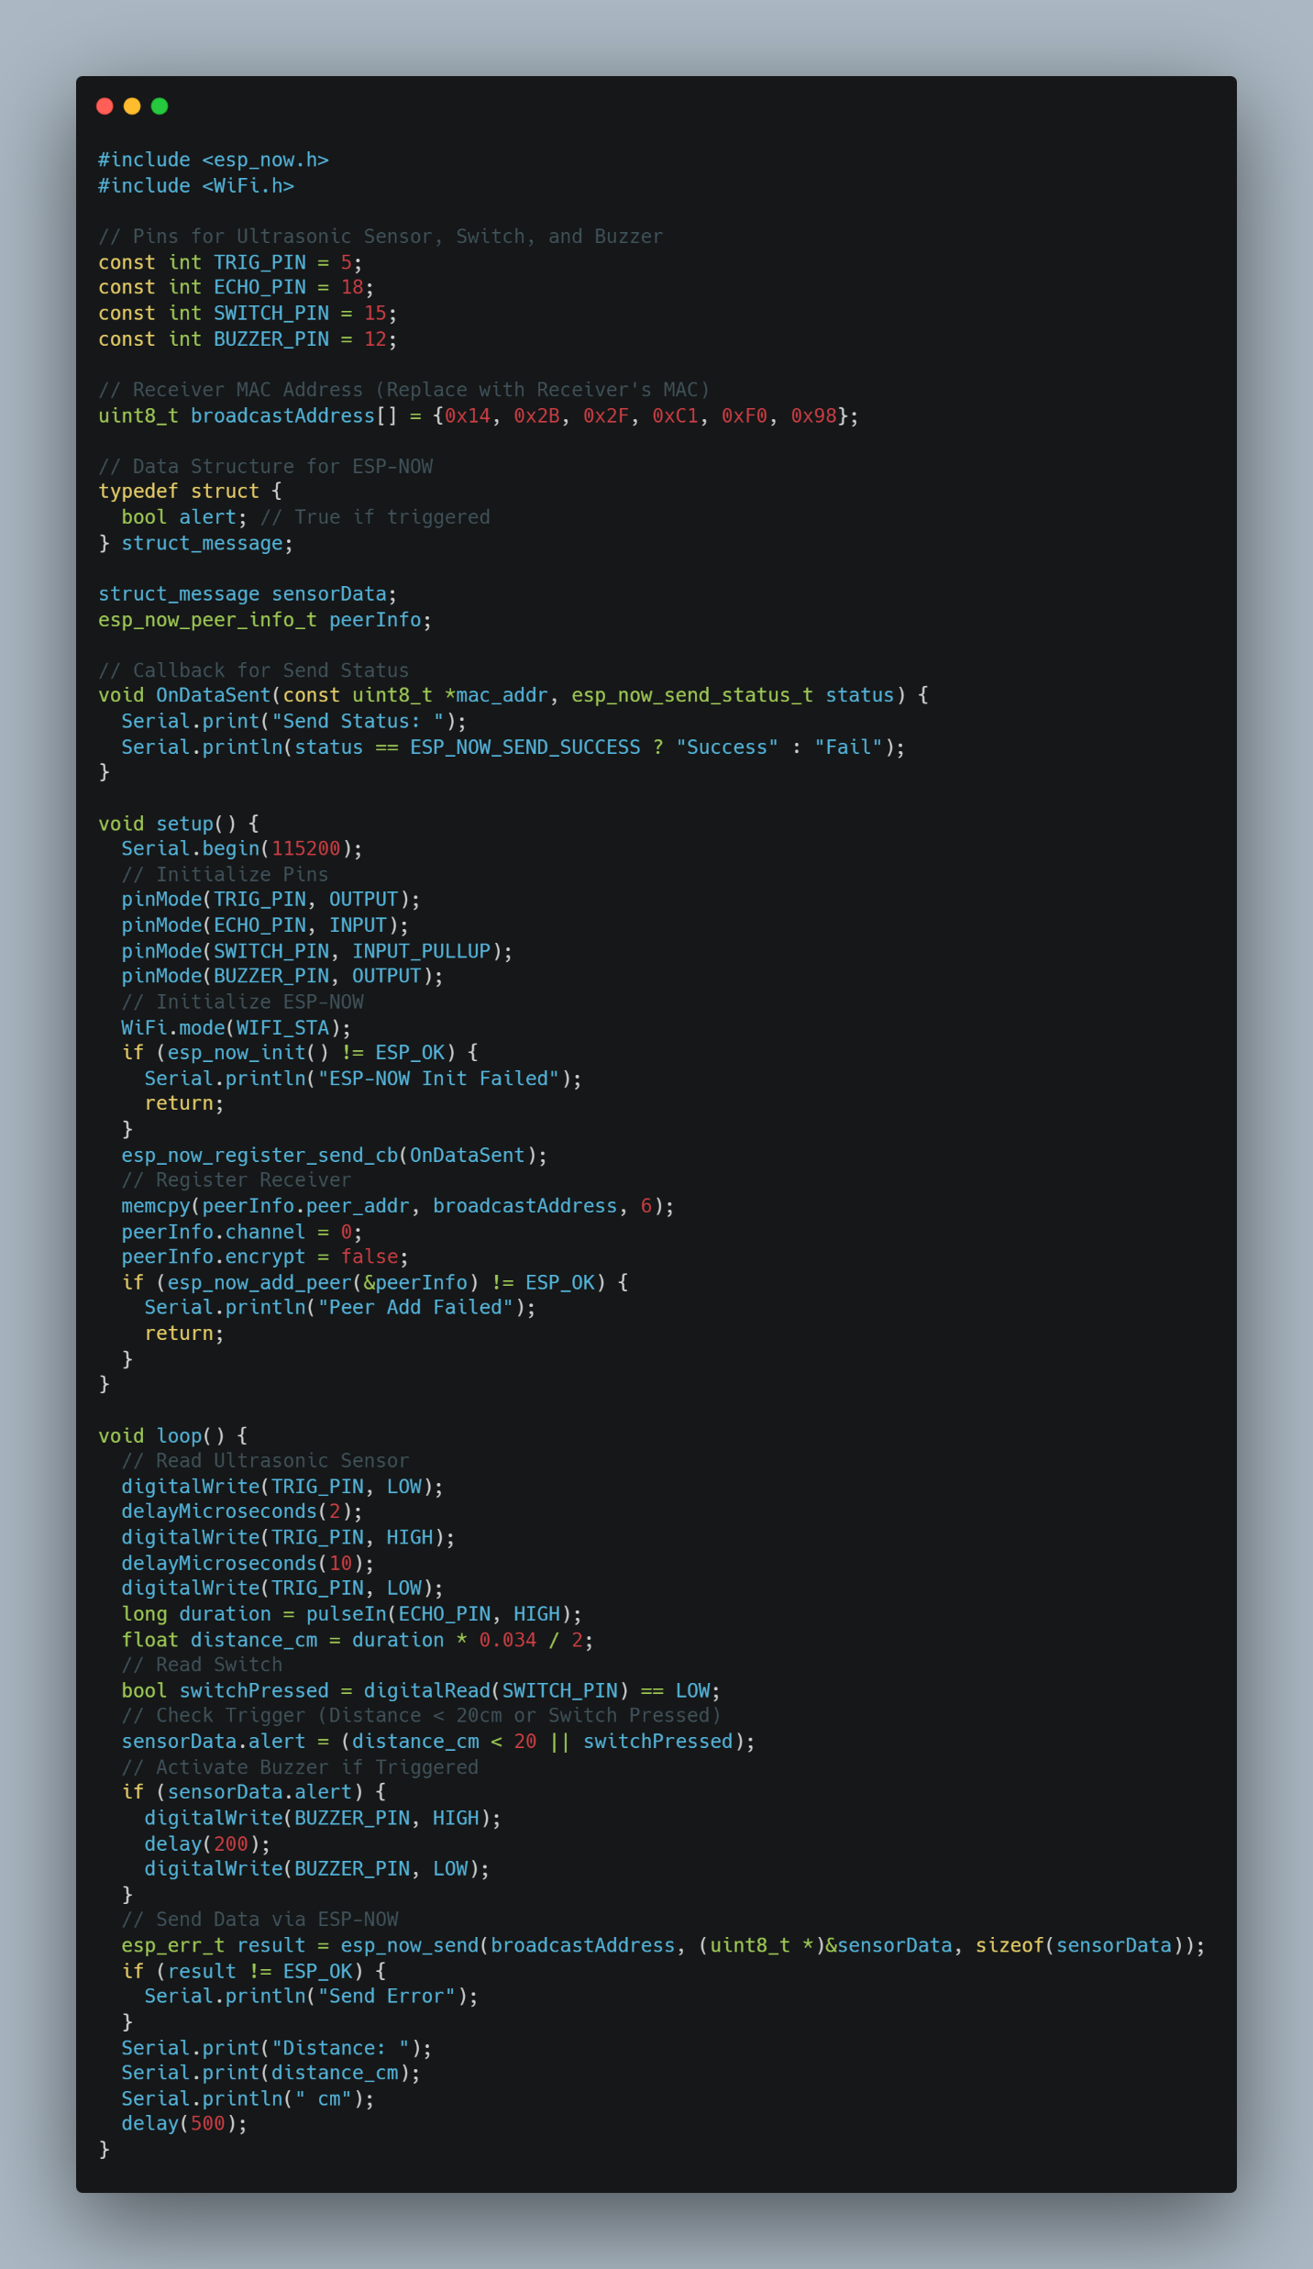
Application
Switch
Code and its Working
SENDER
Sender Code for Bell
The ESP32 code implements a wireless doorbell system using **ESP-NOW** for communication, paired with an **HC-SR04 ultrasonic sensor** to detect objects within 20 cm. It includes libraries esp_now.h and WiFi.h to enable ESP-NOW, a low-latency, Wi-Fi-based protocol. In setup(), the code initializes serial communication (115200 baud), configures the ultrasonic sensor pins (TRIG: GPIO 5, ECHO: GPIO 18), sets the ESP32 to Wi-Fi station mode, and initializes ESP-NOW with a callback (OnDataSent) to confirm transmission status. It registers a peer using a predefined receiver MAC address. In loop(), the ultrasonic sensor measures distance by sending a 10µs pulse to TRIG, calculating distance (distance_cm = duration * 0.034 / 2) from the ECHO pulse duration, and setting a boolean alert in a custom struct_message to true if the distance is under 20 cm. This alert status is sent wirelessly to the receiver via ESP-NOW every 500m, with serial output for debugging distance and send status.
CODE
In the wireless doorbell prototype, the switch (SW) acts as a manual trigger to activate the buzzer, complementing the ultrasonic sensor’s automated detection. Connected to an ESP32 GPIO pin, it completes an electrical circuit when pressed, signaling the ESP32 to sound the buzzer. This provides a reliable backup if the sensor fails to detect a visitor, ensures easy testing during development, and offers a familiar, user-friendly interface like a traditional doorbell button. Its low-power, compact design integrates seamlessly into the breadboard setup, enhancing the system’s versatility and functionality.

Slide 22
Code and its Working
SENDER
Sender Code for Bell
Receiver Code for Bell
The ESP32 code configures a receiver for a wireless doorbell system using ESP-NOW to receive data and control a buzzer. It includes esp_now.h and WiFi.h for ESP-NOW communication. A struct_message with a boolean alert field matches the sender’s data structure. In setup(), the code initializes serial communication (115200 baud), sets the buzzer pin (GPIO 23) as output (initially LOW), configures the ESP32 in Wi-Fi station mode, and initializes ESP-NOW. It registers a callback function OnDataRecv to handle incoming data. When data is received, OnDataRecv copies the incoming alert status into receivedData, toggles the buzzer HIGH if alert is true (object detected within 20 cm by the sender) or LOW if false, and prints the alert status ("ACTIVE" or "Inactive") to the serial monitor. The loop() function remains empty, as the system operates via the callback, continuously responding to ESP-NOW messages to control the buzzer.
CODE
The ESP32 code implements a wireless doorbell system using **ESP-NOW** for communication, paired with an **HC-SR04 ultrasonic sensor** to detect objects within 20 cm. It includes libraries esp_now.h and WiFi.h to enable ESP-NOW, a low-latency, Wi-Fi-based protocol. In setup(), the code initializes serial communication (115200 baud), configures the ultrasonic sensor pins (TRIG: GPIO 5, ECHO: GPIO 18), sets the ESP32 to Wi-Fi station mode, and initializes ESP-NOW with a callback (OnDataSent) to confirm transmission status. It registers a peer using a predefined receiver MAC address. In loop(), the ultrasonic sensor measures distance by sending a 10µs pulse to TRIG, calculating distance (distance_cm = duration * 0.034 / 2) from the ECHO pulse duration, and setting a boolean alert in a custom struct_message to true if the distance is under 20 cm. This alert status is sent wirelessly to the receiver via ESP-NOW every 500m, with serial output for debugging distance and send status.

Slide 23
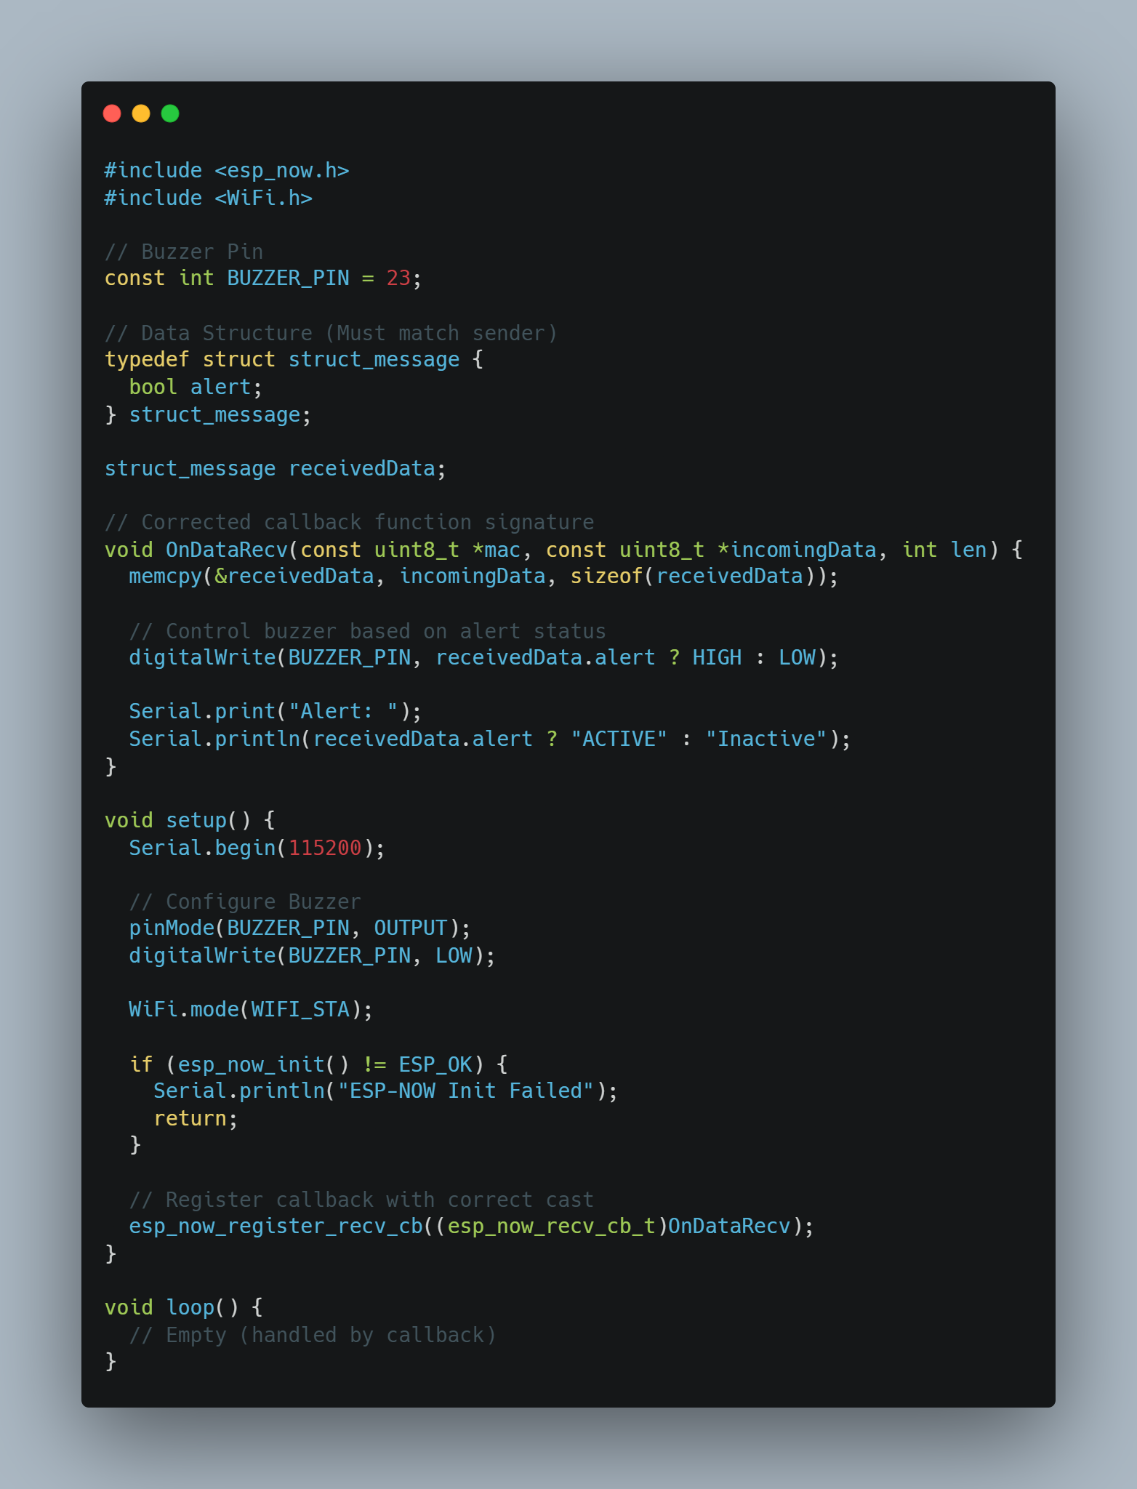
RECEIVER
Code and its Working
SENDER
Receiver Code for Bell
The ESP32 code configures a receiver for a wireless doorbell system using ESP-NOW to receive data and control a buzzer. It includes esp_now.h and WiFi.h for ESP-NOW communication. A struct_message with a boolean alert field matches the sender’s data structure. In setup(), the code initializes serial communication (115200 baud), sets the buzzer pin (GPIO 23) as output (initially LOW), configures the ESP32 in Wi-Fi station mode, and initializes ESP-NOW. It registers a callback function OnDataRecv to handle incoming data. When data is received, OnDataRecv copies the incoming alert status into receivedData, toggles the buzzer HIGH if alert is true (object detected within 20 cm by the sender) or LOW if false, and prints the alert status ("ACTIVE" or "Inactive") to the serial monitor. The loop() function remains empty, as the system operates via the callback, continuously responding to ESP-NOW messages to control the buzzer.
CODE

Slide 24
Code and its Working
Receiver Code for Bell
RECEIVER
CODE
The ESP32 code configures a receiver for a wireless doorbell system using ESP-NOW to receive data and control a buzzer. It includes esp_now.h and WiFi.h for ESP-NOW communication. A struct_message with a boolean alert field matches the sender’s data structure. In setup(), the code initializes serial communication (115200 baud), sets the buzzer pin (GPIO 23) as output (initially LOW), configures the ESP32 in Wi-Fi station mode, and initializes ESP-NOW. It registers a callback function OnDataRecv to handle incoming data. When data is received, OnDataRecv copies the incoming alert status into receivedData, toggles the buzzer HIGH if alert is true (object detected within 20 cm by the sender) or LOW if false, and prints the alert status ("ACTIVE" or "Inactive") to the serial monitor. The loop() function remains empty, as the system operates via the callback, continuously responding to ESP-NOW messages to control the buzzer.

Slide 25




Possible Enhancement
RECEIVER
Application
Add a Mobile App Notification System:
By Integrating the ESP 32’ s Wi-Fi Capabilities to send push notifications to a smartphone app when the ultrasonic sensor detects a visitor by using a platform like Blynk or MQTT to create a simple app interface. This allows remote alert and monitoring, improving accessibility over a standalone buzzer
01
02
Visitors are detected automatically when they come close to the door (e.g., within 50 cm), eliminating the need to press a button. This promotes hygiene and is ideal for hospitals, homes, and public spaces.
Detects when someone approaches the front gate or entrance, and wirelessly notifies people inside the house or office.
CODE
Contactless
Entrance Monitor
2.: Implement Power saving mode:
By Optimizing power consumption by putting the ESP32 and Arduino into sleep modes when idle and use the ultrasonic sensor’s interrupt to wake the system only when motion is detected. Add a low-power LED indicator to show system status, reducing battery drain for a more practical, long-lasting prototype.
3. Incorporate a Camera Module:
By adding a low-cost camera module. We can have the ESP32 to capture images or video when the doorbell is triggered. We can store the images on an SD card or stream them to a mobile app. This enhances security by providing visual confirmation of visitors, making the doorbell more functional.
04
03
Elderly or physically challenged individuals can trigger alerts by simply waving near the sensor — no need to reach for a button or device.
Automatically senses visitor presence outside meeting rooms or reception areas, and alerts staff via buzzer, display, or mobile notification.
Vision Alert
Automatic
4. Enhance User Feedback with Multi-Tone Alerts:
By Upgrading the buzzer to support multiple tones or melodies to differentiate between events (e.g., visitor detection vs. system errors). Alternatively, adding a small OLED display to show status messages like “Visitor Detected” or battery levels, improves user interaction and clarity.

Slide 26



01
Thank You
Visitors are detected automatically when they come close to the door (e.g., within 50 cm), eliminating the need to press a button. This promotes hygiene and is ideal for hospitals, homes, and public spaces.
Vision Alert
02
Automatic
Detects when someone approaches the front gate or entrance, and wirelessly notifies people inside the house or office.
Possible Enhancement
Add a Mobile App Notification System:
By Integrating the ESP 32’ s Wi-Fi Capabilities to send push notifications to a smartphone app when the ultrasonic sensor detects a visitor by using a platform like Blynk or MQTT to create a simple app interface. This allows remote alert and monitoring, improving accessibility over a standalone buzzer
2.: Implement Power saving mode:
By Optimizing power consumption by putting the ESP32 and Arduino into sleep modes when idle and use the ultrasonic sensor’s interrupt to wake the system only when motion is detected. Add a low-power LED indicator to show system status, reducing battery drain for a more practical, long-lasting prototype.
3. Incorporate a Camera Module:
By adding a low-cost camera module. We can have the ESP32 to capture images or video when the doorbell is triggered. We can store the images on an SD card or stream them to a mobile app. This enhances security by providing visual confirmation of visitors, making the doorbell more functional.
4. Enhance User Feedback with Multi-Tone Alerts:
By Upgrading the buzzer to support multiple tones or melodies to differentiate between events (e.g., visitor detection vs. system errors). Alternatively, adding a small OLED display to show status messages like “Visitor Detected” or battery levels, improves user interaction and clarity.
03
Application
04
Automatically senses visitor presence outside meeting rooms or reception areas, and alerts staff via buzzer, display, or mobile notification.
Elderly or physically challenged individuals can trigger alerts by simply waving near the sensor — no need to reach for a button or device.
Contactless
Entrance Monitor

Slide 27
Possible Enhancement
Add a Mobile App Notification System:
By Integrating the ESP 32’ s Wi-Fi Capabilities to send push notifications to a smartphone app when the ultrasonic sensor detects a visitor by using a platform like Blynk or MQTT to create a simple app interface. This allows remote alert and monitoring, improving accessibility over a standalone buzzer
Thank You
2.: Implement Power saving mode:
By Optimizing power consumption by putting the ESP32 and Arduino into sleep modes when idle and use the ultrasonic sensor’s interrupt to wake the system only when motion is detected. Add a low-power LED indicator to show system status, reducing battery drain for a more practical, long-lasting prototype.
3. Incorporate a Camera Module:
By adding a low-cost camera module. We can have the ESP32 to capture images or video when the doorbell is triggered. We can store the images on an SD card or stream them to a mobile app. This enhances security by providing visual confirmation of visitors, making the doorbell more functional.
4. Enhance User Feedback with Multi-Tone Alerts:
By Upgrading the buzzer to support multiple tones or melodies to differentiate between events (e.g., visitor detection vs. system errors). Alternatively, adding a small OLED display to show status messages like “Visitor Detected” or battery levels, improves user interaction and clarity.

